Slide 1

Python Fundamentals — Day 1 (Online)
Friendly, hands-on introduction to Python for beginner programmers. By the end of today you'll install tools, write your first programs, and understand core language building blocks: variables, control flow, loops, and basic data structures.

Slide 2

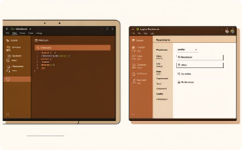
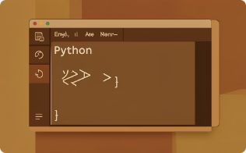
Welcome & Setup
What is Python?
Install & IDE
Run Your First Program
High-level, readable language used for web, data, automation, and more. Great for beginners because of clear syntax and big community.
Install Python 3.x. Recommended editors: VS Code, PyCharm, or Jupyter for notebooks. We'll show quick setup steps and shortcuts.
Use the interpreter or a .py file. Example: print(\"Hello, world!\"). We'll practice running code interactively.

Slide 3
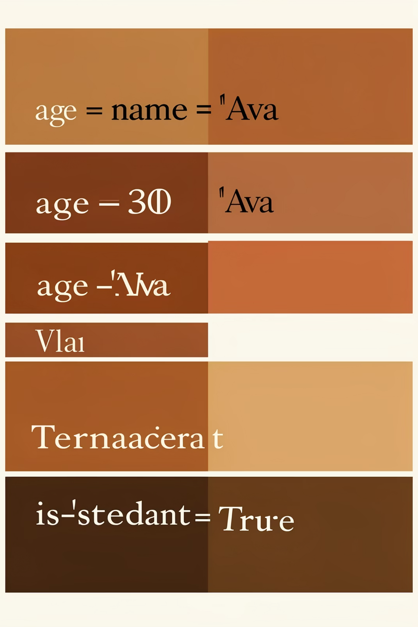
Variables & Data Types
Variables
Common Data Types
Type Conversion & Checking
Names that store data. Variables must start with a letter or an underscore, followed by letters, numbers, or underscores. They are case-sensitive. Always choose clear and descriptive names to improve code readability.
int (integers, whole numbers): age = 25float (floating-point numbers, decimals): price = 19.99str (strings, text enclosed in quotes): name = "Alice"bool (booleans, True or False): is_active = True
Convert between types using functions like int(), float(), and str(). You can check a variable's type with the type() function.
Examples:
num_str = "10"num_int = int(num_str) (output: 10)print(type(age)) (output: <class 'int'>)
Examples:
age = 25user_name = "Alice"

Slide 4
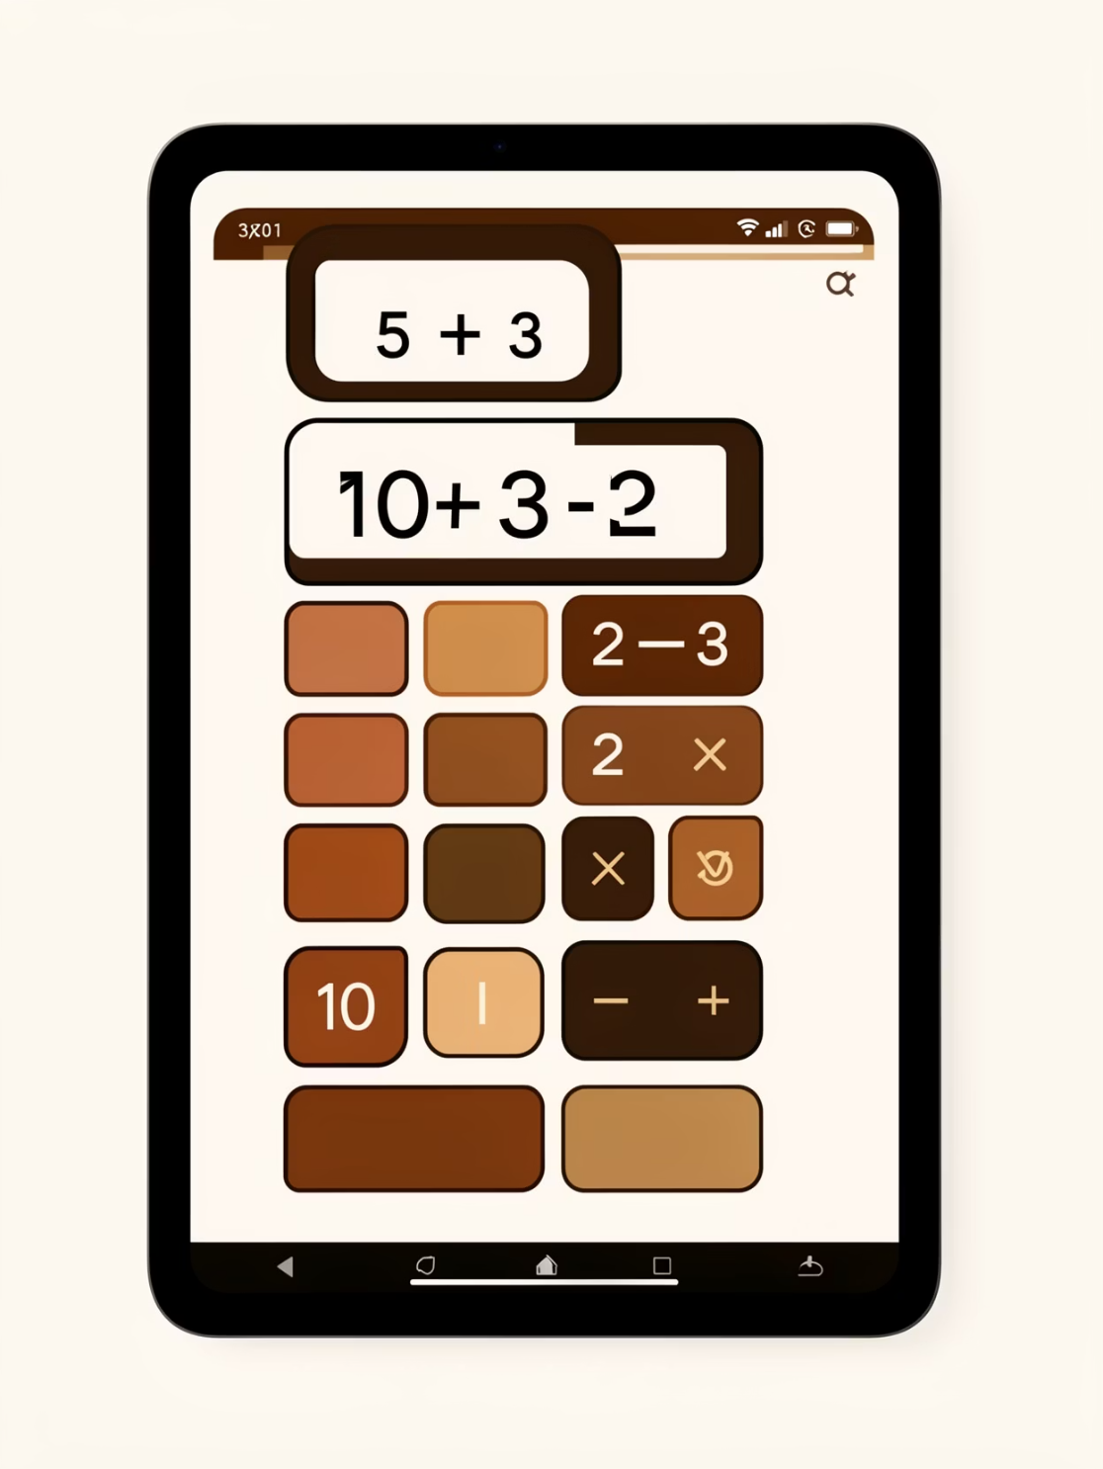
Operators at a Glance
Arithmetic: + (addition), - (subtraction), * (multiplication), / (division), // (floor division), % (modulo), ** (power) These operators perform mathematical calculations. Examples: 10 + 5 evaluates to 15 10 - 3 evaluates to 7 10 * 2 evaluates to 20 10 / 3 evaluates to 3.333... (float division) 10 // 3 evaluates to 3 (floor division, rounds down to nearest whole number) 10 % 3 evaluates to 1 (modulo, remainder of division) 2 ** 3 evaluates to 8 (power, 2 to the power of 3)
Comparison: == (equal to), != (not equal to), > (greater than), < (less than), >= (greater than or equal to), <= (less than or equal to) Used to compare two values and return a boolean (True or False). Examples: 5 == 5 evaluates to True 5 != 3 evaluates to True 5 > 3 evaluates to True 3 < 5 evaluates to True 5 >= 5 evaluates to True 3 <= 5 evaluates to True
Logical: and, or, not Combine or modify boolean expressions. Examples: True and False evaluates to False True or False evaluates to True not True evaluates to False
Try small expressions in the REPL to see results immediately.

Slide 5
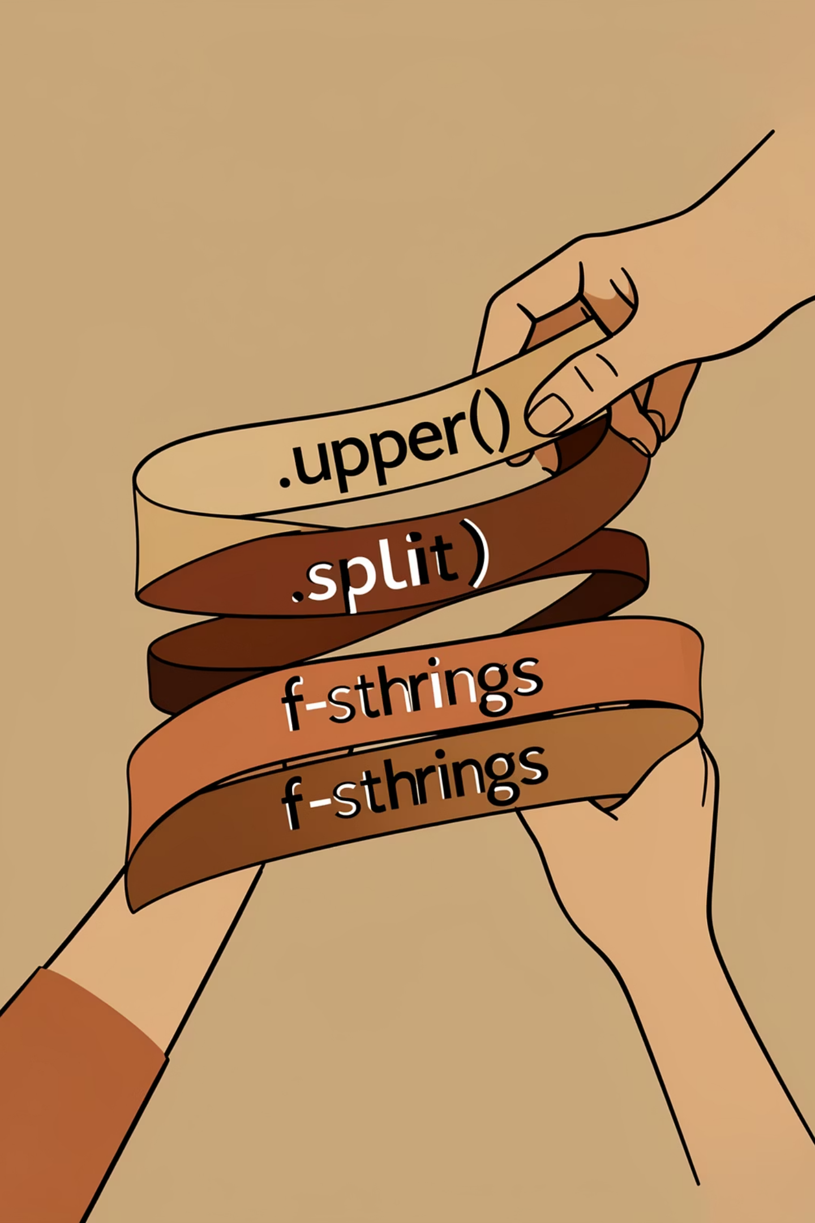

Strings: Manipulate Text
Indexing & Slicing
Access characters with s[0], ranges with s[1:4]. Negative indices count from the end.
Methods
Common: .lower(), .strip(), .replace(), .split().
Formatting
Use f-strings: f\"Name: {name}, Age: {age}\" for readable interpolation.

Slide 6
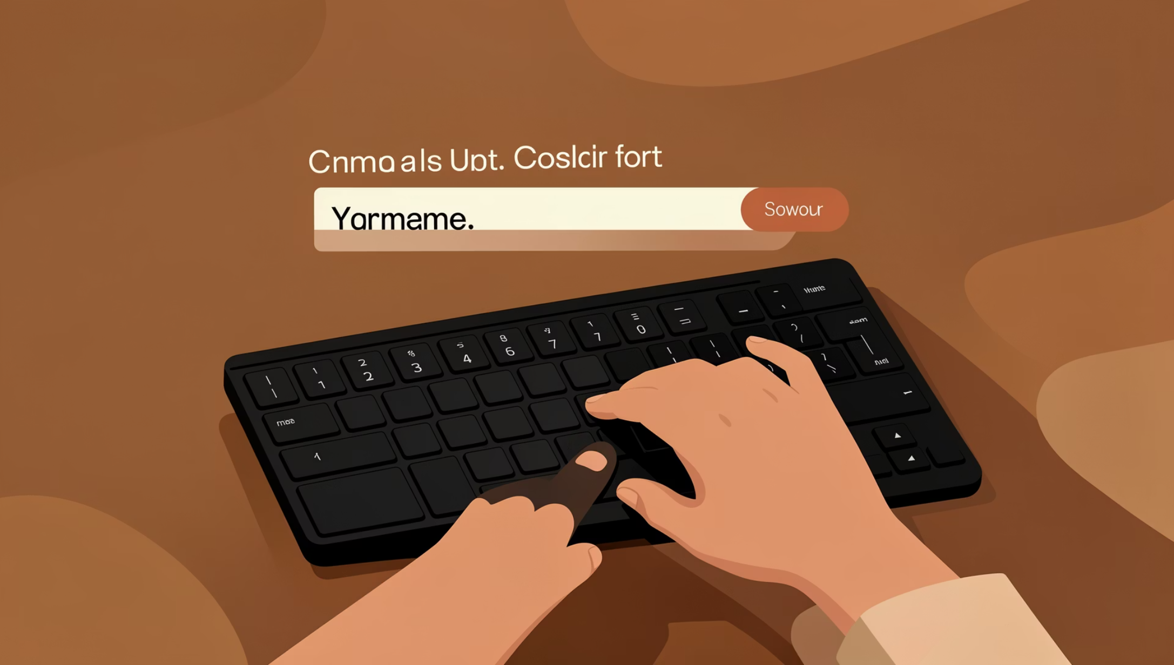
Input & Output
Print with print() — format with commas or f-strings. Get user input with input(), which returns a string.
Convert input to numbers: age = int(input(\"Age: \")). Always validate or handle exceptions for robust code.

Slide 7
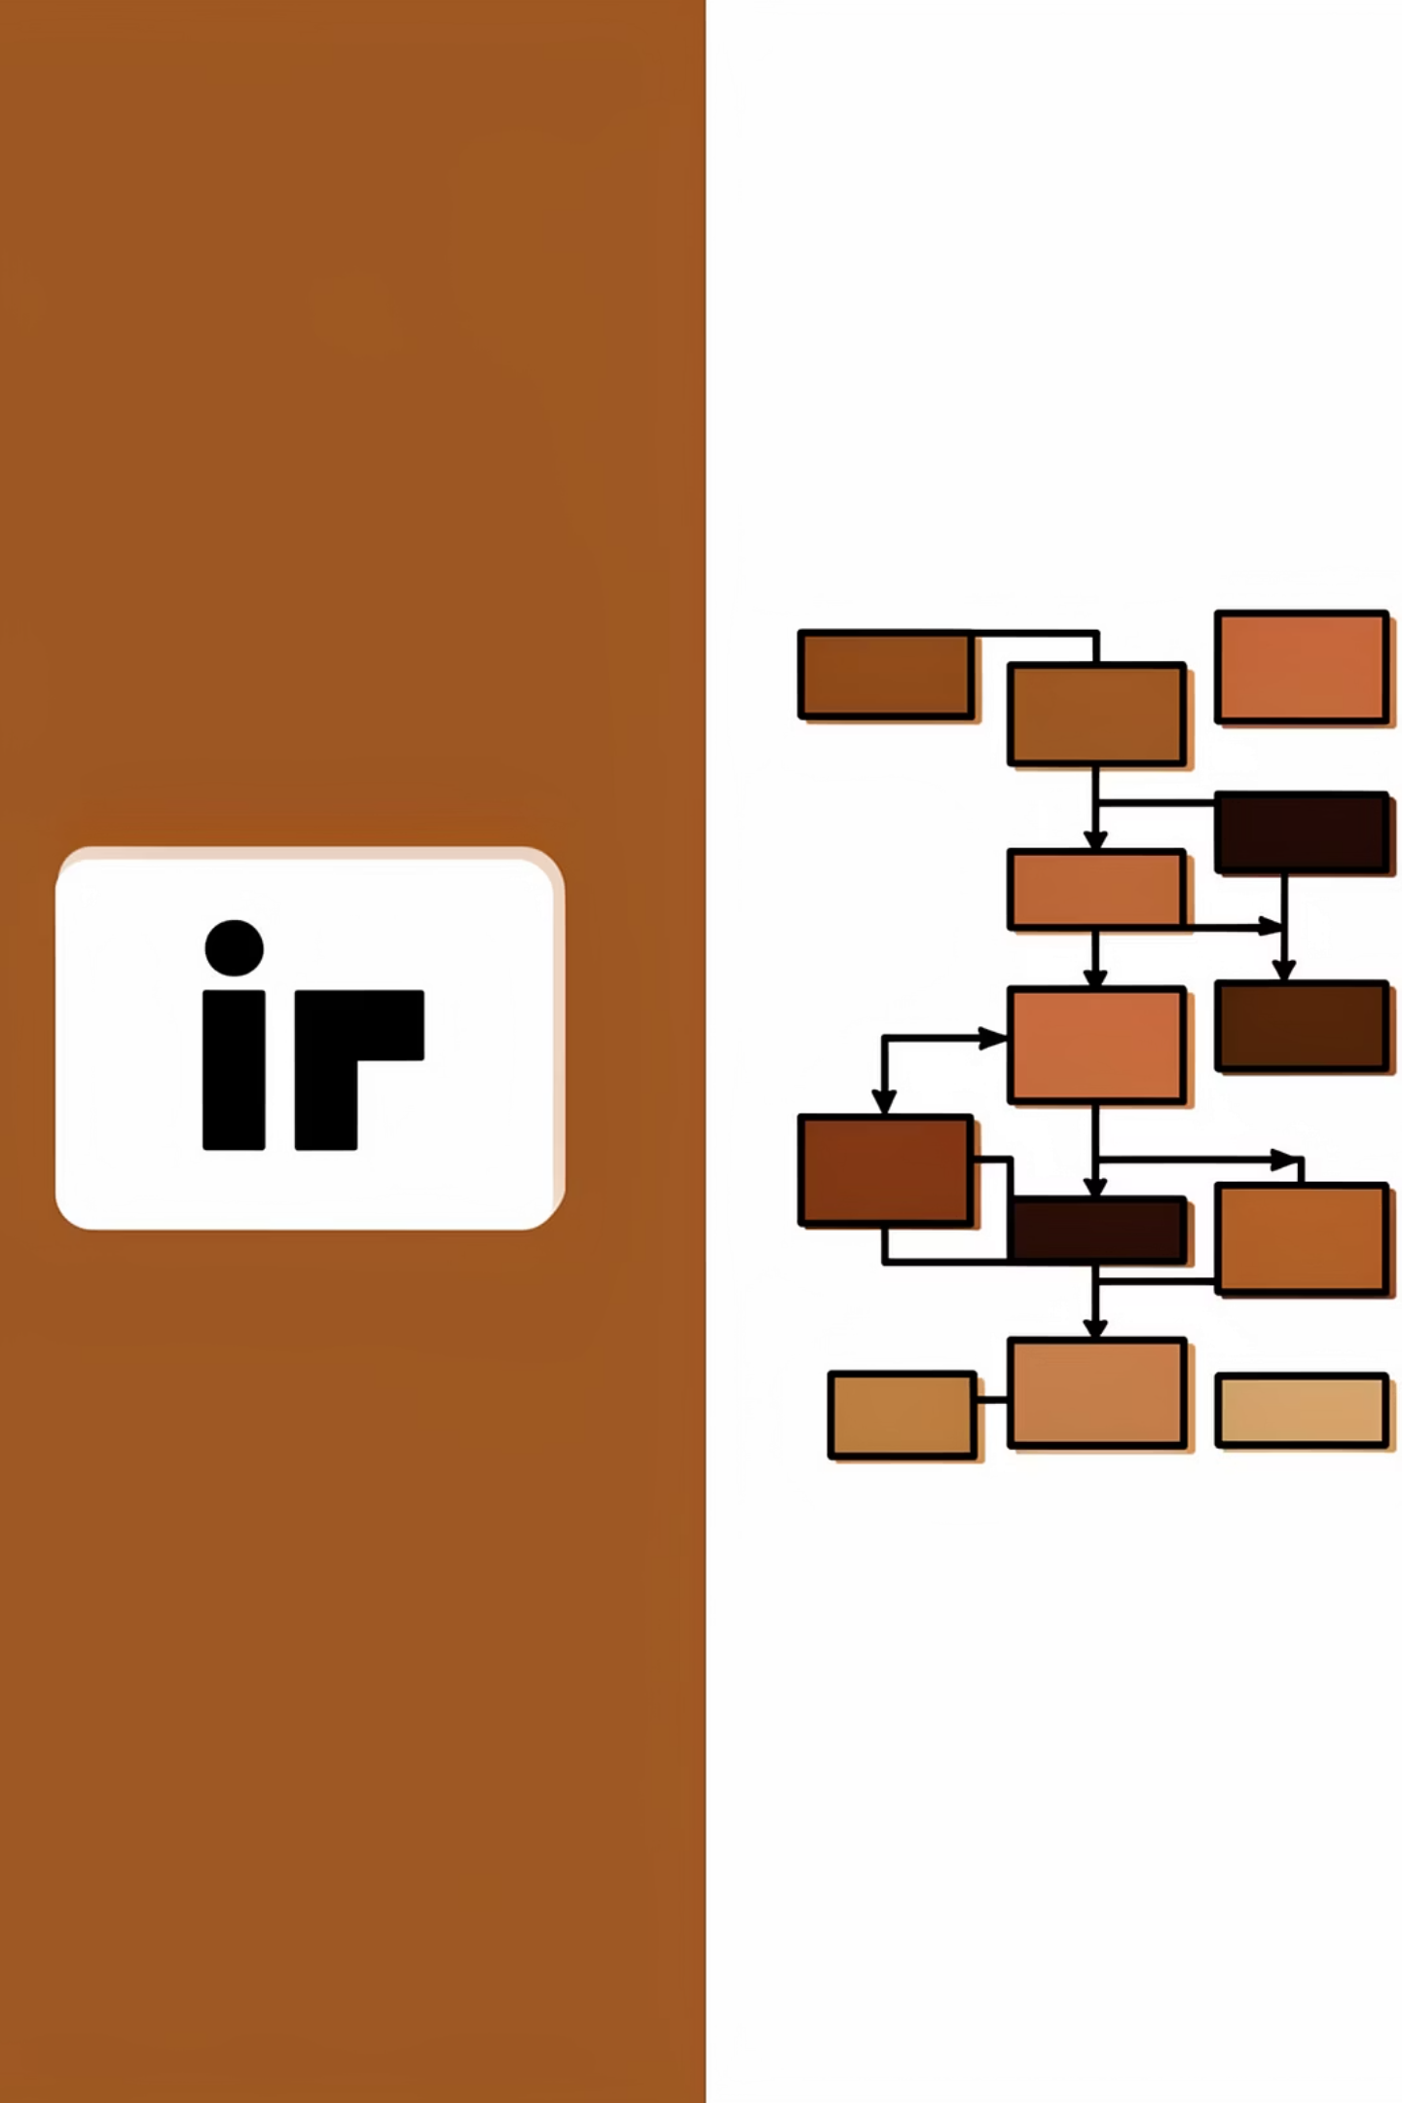
Conditionals
01
02
If / Elif / Else
Nested Conditions
Use to branch logic: if score >= 90: ... elif score >= 80: ... else: ...
Place one conditional inside another when needed, but keep it readable — prefer helper functions for complexity.
03
Ternary Operator
Short conditional: state = \"open\" if is_open else \"closed\".

Slide 8
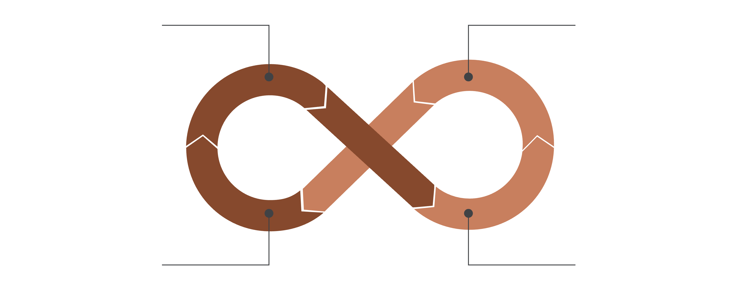
For Loop (range/list)
While Loop (condition)
Break (exit)
Continue (skip)
Use loops to repeat work. For known iterations use for with range() or lists; for conditional repetition use while. Control flow: break exits, continue skips to next iteration, pass is a placeholder.

Slide 9
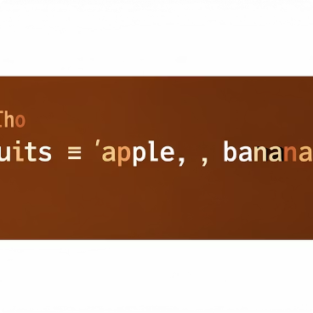
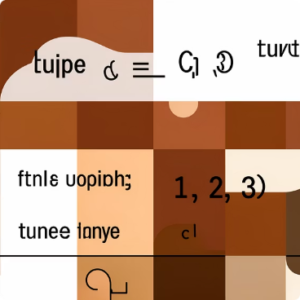
Basic Data Structures
Lists
Tuples
Mutable sequences. Common methods: append(), insert(), remove(), pop(), sort(). Use slicing and comprehensions for concise code.
Immutable sequences. Great for fixed collections and safe unpacking: a, b = (1,2).

Slide 10

Wrap-up & Next Steps
Key Takeaways
Practice Tasks
Install Python, practice variables, conditionals, loops, and lists. Use the REPL to explore quickly.
1) Build a simple calculator 2) Create a guessing game 3) Manipulate a list of names
Resources
Official Python docs, interactive tutorials (Replit, Codecademy), and the workshop code samples shared after class.

